Slide 1

CLICK THROUGH RATE - prediction
Selva kumar

Slide 2
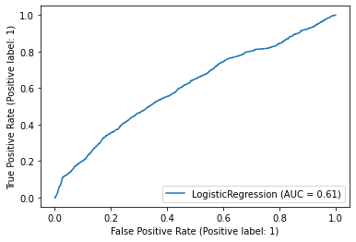
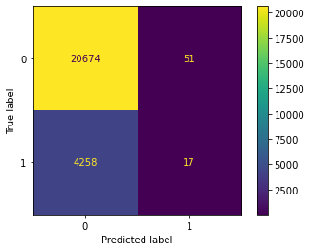
Logistic Regression
Model is not able to predict 4258 clicks, which means we made this model biased to the imbalanced dataset.
The accuracy is just the same as Dummy Classifier with most frequent prediction

Slide 3
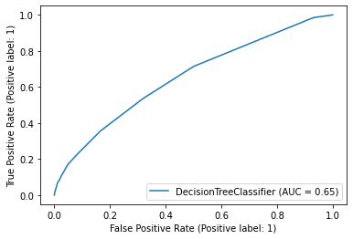
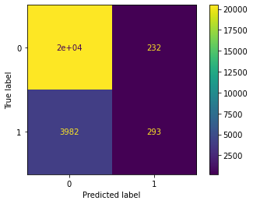
Decision Tree
In this modelling we have slight improvement but not so great.
Even though Decision tree has highest AUC of .65 among other models
It predicted most True Negative than any other model and so, it can tell us when an ad will not be clicked. It is not our point of interest.

Slide 4

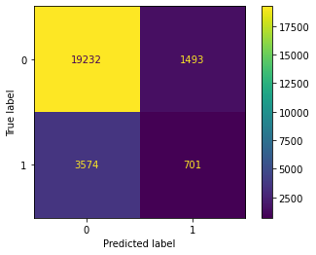
Ensemble - Random Forest
Ensemble – Random Forest model almost gave similar result as Decision with slightly less accuracy.
It predicted most clicks among the other model which we observed.
And since our interest is to predict when an advertisement will be clicked, we can use this ensemble model to predict.

